Slide 1
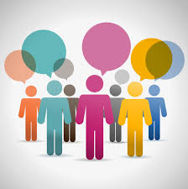
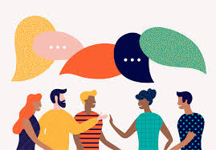
Lecture: 03
COMMUNICATION FUNDAMENTALS
(Empathy, conversational Skills, established listening, Respected vocabulary, turn taking)

Slide 2
Aims & objectives
Aim: To introduce fundamental concepts of Communication
Objectives: After the session learners will be able to:
Define the fundamental concepts of Communication
Strategize & employ the learned concepts in Communication
Differentiate between accepted/respected Vocabulary and colloquial.
Understand the importance of turn-taking and introspection.
Assessment: Discussion Prompts incorporated between the lecture, debrief session at the end of the class and mini task assigned for home.

Slide 3
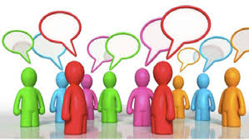
What creates an impactful and meaningful communication?

Slide 4
It has to be
1. what you say.
2. How you say.
3. And when you say it.

Slide 5
Communication fundamentalS
Empathy
Conversational Skills
Established listening
Respected vocabulary
Introspection and turn taking

Slide 6

What does this picture show?

Slide 7
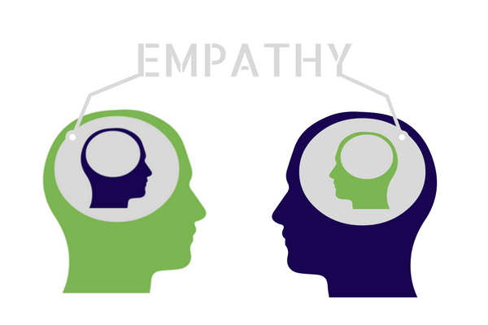
EMPATHY
The dictionary defines it as “the quality or process of entering fully, through imagination, into another’s feelings or motives.”
In the fullest sense, it implies putting yourself into the other person’s shoes, or even getting into his or her skin, so that you really understand them.
“You never really understand a person until you consider things from his point of view… until you climb into his skin and walk around in it.”
To kill a mockingbird, Harper Lee
It means identifying with and understanding the thoughts, feelings and experiences of someone else. It doesn’t mean you completely understand. It doesn’t mean you agree.
Demonstrating empathy means you seek to understand and seek to help another person feel understood.

Slide 8
Do you believe empathy is vital for effective communication? And why?

Slide 9
Empathy and communication
Empathy is vital for good communication.
Empathy helps us to communicate our ideas in a way that makes sense to others, and it helps us understand others when they communicate with us.
It is one of the foundational building blocks of great social interaction and, quite obviously, powerful stuff.
Consider these suggestions for being empathetic as you communicate your ideas
Successful communication is a two-way process. People must present their ideas in a form others can understand, and they must, in turn, listen to others to understand how the message is received.

Slide 10
Organize your ideas. Present your ideas in an organised way. Be sure your ideas and your thinking are crystal clear to you. Write them down. Arrange them in light of what you know about others.
Tap into people’s interests. Present your ideas to others in a form that highlights their benefits. Strive to understand people’s needs and expectations and phrase your ideas in those terms to communicate effectively.
Vary your communication style. Use the communication style most comfortable and familiar to your listener. Adjust your style to enable your listener to understand and accept your message without the need to “translate” it.

Slide 11
We’ve seen lack of empathy on the world stage U.S. Presidential and Brexit elections. Pollsters and political party leaders didn’t understand voters. Politicians spent more time criticizing than listening to each other. Citizens have taken sides and set up simplified caricatures of others without fully seeking to understand them.
We need more empathy in the political realm, but we also need more empathy in communities, families, business and all aspects of life.
Benefits of Empathic Listening
Builds teamwork
Gain trust
Elicit openness
Gain a sharing of ideas and thoughts.
Obtain more valid information about the speakers and the subject

Slide 12

How do you get empathy?
How do you understand what someone else is feeling, if that isn't happening automatically?

Slide 13
Well, to a certain extent we are all designed to naturally empathize with others. Our brains are wired to experience the emotions that someone else is feeling. That's why we wince when someone hits their hand with a hammer, or why we're more likely to laugh if someone else is laughing too.
Demonstrating empathy takes effort and practice.
To demonstrate empathy, most of us need to follow these tips:
Talk less, listen more.
Listen to connect.
Let the other person go first.
Let people know you understand before moving on.

Slide 14
CONVERSATIONAL SKILLS
"Talking is creating confusion".
Nobody wants it, nevertheless the above proverb has often emerged. Leading a conversation that leads to a suitable conclusion often proves to be difficult. The effect of words can be different from what was foreseen, so confusion and misunderstanding may result.
It is of importance, to avoid such situations as much as possible in a culture as ours, where conversations play a crucial role.
With the help of certain skills a conversation can be carefully prepared and its guidance and evaluation enhanced.

Slide 15

Why is it important to cultivate good conversational skills?

Slide 16
CONVERSATIONAL SKILLS
Conversations are generally thought of as casual informal chats which are primarily used to build rapport.
However, conversations can take place in a more formal context and can have a variety of purposes, including persuading, demonstrating expertise or negotiating a business deal.
One misunderstanding of conversational skills is the belief that personality traits and language proficiency are solely responsible for sustaining a conversation.
This view neglects other aspects, such as the participants’ perceptions of themselves and their conversation partners. For example, if someone believes that their conversation partner is unfriendly, it is unlikely that they are going to put in much effort into sustaining the interaction.

Slide 17
Conversation skills include an ability to initiate, sustain and end a conversation.
A lack of any one of these skills may result in individuals initiating new topics inappropriately or ending a conversation abruptly. While it is important to know how to sustain a conversation, it is equally important to know how to begin it and when to end it.

Slide 18
Components of a good conversationalist
To know about any topic, culture, politics, sports, entertainment, others.
Information means power to be a good observer.
Eye contact/To smile/Create a good atmosphere.
Initiative/tranquility.
Presentation/ To find deals in common.
To show interest respectfully.
To hear the other person.
to make them feel they the center of attention.
To use follow up questions.
To give my opinion but respect other’s opinions.
To ask for advice.
Do not interrupt. Do not hog the conversation. Wait to give your opinion.

Slide 19
BASIC SKILLS FOR GOOD CONVERSATION
Conversation is a challenging activity, because during it you must do several things at the same time: listen (and mentally process the information so you can understand), think about what you'll want to say when you respond, and speak (so you can be understood).
GOOD IDEAS AND LANGUAGE SKILL - pronunciation, grammar & word order, pacing, appropriate (for audience & message), is important for effective communication.
Develop a clear goal (what do you want to say?) with ideas (to say information, ask questions, persuade for argument or a sale) expressed in way listener/reader can understand (what do they know, what is their perspective? can you appeal to their interests?) and check for feedback from listeners (do they look interested? confused?) so you can adjust what you are saying, and how you say it.

Slide 20
LISTENING SKILLS:
listening is important, so listen to speaker with your full attention; minimize external distractions (or ignore them), and try to minimize internal distractions (when you're multi-tasking with your attention being split between listening and your own thinking).
SPEAKING SKILLS:
PACING — Speak more slowly.
Why?
give LISTENER more time to hear & mentally process your WORDS (more difficult to understand due to your accent) and IDEAS, and for you to provide logical "cues" about your ideas" by using brief pausing-stops to emphasize important words and to clarify the logical structure of your ideas; this also lets a listener "catch up with you" and think about what you are saying.
give YOU more time to plan your own IDEAS and word-order, and to self-monitor your own PRONUNCIATION.
LOUDNESS — Speak more loudly. (details are in handout, outline-summary is below) If you speak with enough loudness, it helps listeners understand your words and ideas even if you speak with some accent

Slide 21
PROPER WORD ORDER
CONFIDENCE In conversations and discussions, be confident and friendly, despite your uncertainties and your frustration at not being able to express ideas with the high level of skillful fluency that you have in your own language.
NONVERBAL COMMUNICATION nonverbal — "body language" with eye contact, tilt of head, face toward listener, general posture (shoulders,...), hand gestures (coordinated with what you're saying)
verbal — For emphasis, give cues about the "important words in a sentence" by combining some or all of these cues to show what you want to emphasize: change of timing (brief pause), loudness, or pitch; plus hand gesture.

Slide 22
Established Listening
There are five key active listening techniques that is important for effective communication:
1. Pay Attention
Give the speaker your undivided attention, and acknowledge the message. Recognize that non-verbal communication also "speaks" loudly.
Look at the speaker directly.
Put aside distracting thoughts.
Don't mentally prepare a rebuttal!
Avoid being distracted by environmental factors. For example, side conversations.
"Listen" to the speaker's body language.

Slide 23
2. Show That You're Listening
Use your own body language and gestures to show that you are engaged.
Nod occasionally.
Smile and use other facial expressions.
Make sure that your posture is open and interested.
Encourage the speaker to continue with small verbal comments like yes, and "uh huh.“ probes.
3. Provide Feedback
Our personal filters, assumptions, judgments, and beliefs can distort what we hear. As a listener, your role is to understand what is being said. This may require you to reflect on what is being said and to ask questions.
Reflect on what has been said by paraphrasing. "What I'm hearing is... ," and "Sounds like you are saying... ," are great ways to reflect back.
Ask questions to clarify certain points. "What do you mean when you say... ." "Is this what you mean?"
Summarize the speaker's comments periodically.

Slide 24
4. Defer Judgment
Interrupting is a waste of time. It frustrates the speaker and limits full understanding of the message.
Allow the speaker to finish each point before asking questions.
Don't interrupt with counter arguments.
5. Respond Appropriately
Active listening is designed to encourage respect and understanding. You are gaining information and perspective. You add nothing by attacking the speaker or otherwise putting her down.
Be candid, open and honest in your response.
Assert your opinions respectfully.
Treat the other person in a way that you think she would want to be treated.

Slide 25
Power of pause
Pause: A pause is a temporary stop or an interval of silence and may vary in length. The speaker may use pauses to have message delivered effectively.
Saying with meaningful pauses is an integral element of meaningful conversation without which no conversation remains interesting and effective for a long time.

Slide 26
We have found that there are five great benefits of learning to use the pause as a conscious skill:
Getting rid of the distracting non-words.
Allows you time to think of what to say next. (I personally find this the most valuable ‘power of the pause.’
Relieves tension, by allowing you to breathe.
Reference your notes.
Dramatize.
Get back on track
Pause makes you sound confident and in control

Slide 27
Introspection and turn taking
Man is a social animal who is gifted with the power of speech. Like other social phenomenon, our conversation and communication also reflects the social organization. Hence, a good communication is also the measure of social engagement and ethics of the participants involved which is reflected with turn taking during conversations in order to allow all participants to express themselves.
What is turn-taking?
Turn-taking occurs in a conversation when one person listens while the other person speaks. As a conversation progresses, the listener and speaker roles are exchanged back and forth (a circle of discussion).

Slide 28
Is turn-taking important?

Slide 29
IMPORTANCE OF TURN TAKING
Turn taking is an important skill for children to develop, in order to effectively participate in social communications. If a child is not able to take turns during interactions, they may interrupt the other person who is speaking or may not actively listen. Children who struggle with turn-taking in social situations may also experience trouble building friendships in class.

Slide 30


Slide 31
RESPECTED VOCABULARY
Have you ever wondered the vocabulary words being spoken in a friend circle or in a court room are quite different from one another?
You must have wondered too that provoking and incendiary words spark reaction, but soft and polite words breed kindness and kindness.

Slide 32
Task
Get through the slides, next class students will be required to talk about the communication Fundamentals

